Slide 1
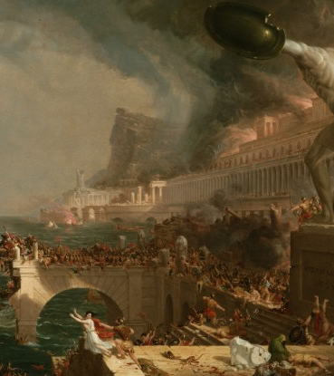
PODCAST
Introduction:
Fall of the Roman Empire: Key Reasons and Relevance for Today (Motivation)
Team: Marco, Antonio, Elsa & Cindy
Notes:
Challenges & Learnings – 1 Min.
Audio File size when adding the chunks back together. Also adding the chunks back together. Stylistic improvements were needed – script not really on point, voices need to be selected.
Demonstration – 2 Min Live Demo
To make it ready: What you would add to make this production-ready? The way we input things now are embedded in the code. To get ready for production, i Think is to get this to market or for a client that needs to create podcast. One thing needed is a user interface to input the URLs or docs. Then the user needs to have a chance to correct the Podcast Script generated. And then maybe select the model and the voice. It would also be nice to create a SRT file for subtitles.

Slide 2
PODCAST
Purpose:
Educational and Informative: Engaging Content on the collapse of one of the mightiest civilizations of all times…
“those that forget the lessons of the past are doomed to repeat them”
Target Audience: General Listeners, and especially those who appreciate the intersection of history and politics
Sources: National Geographic, BBC, History Today, Wikipedia
Notes:
Challenges & Learnings – 1 Min.
Audio File size when adding the chunks back together. Also adding the chunks back together. Stylistic improvements were needed – script not really on point, voices need to be selected.
Demonstration – 2 Min Live Demo
To make it ready: What you would add to make this production-ready? The way we input things now are embedded in the code. To get ready for production, i Think is to get this to market or for a client that needs to create podcast. One thing needed is a user interface to input the URLs or docs. Then the user needs to have a chance to correct the Podcast Script generated. And then maybe select the model and the voice. It would also be nice to create a SRT file for subtitles.

Slide 3
PODCAST
Challenges & Learnings:
Chunking, Audio File Size, Podcast Script, Voice Options, GitHub Commit Size
Notes:
Challenges & Learnings – 1 Min.
Audio File size when adding the chunks back together. Also adding the chunks back together. Stylistic improvements were needed – script not really on point, voices need to be selected.
Demonstration – 2 Min Live Demo
To make it ready: What you would add to make this production-ready? The way we input things now are embedded in the code. To get ready for production, i Think is to get this to market or for a client that needs to create podcast. One thing needed is a user interface to input the URLs or docs. Then the user needs to have a chance to correct the Podcast Script generated. And then maybe select the model and the voice. It would also be nice to create a SRT file for subtitles.

Slide 4
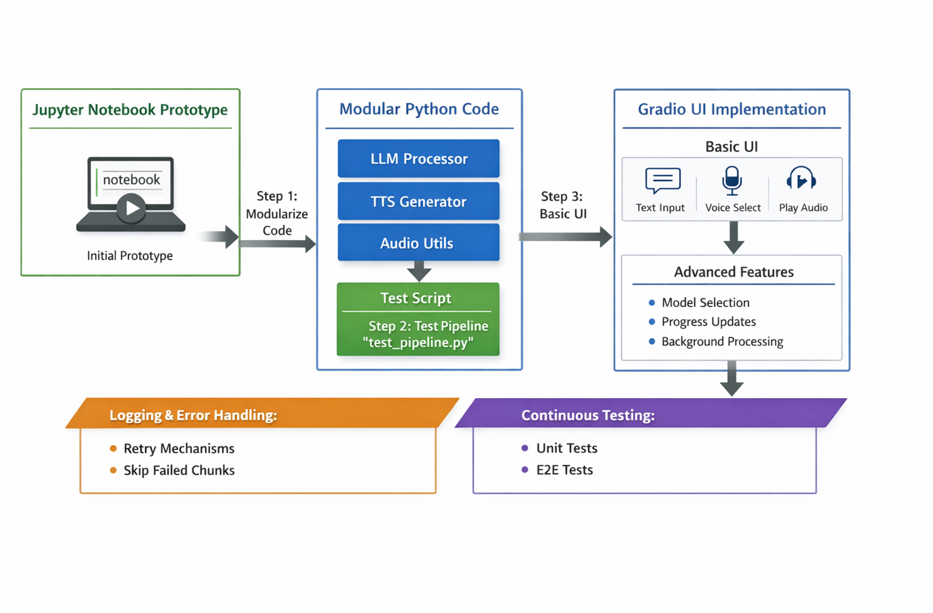
Production Ready Next Steps
* Improve User Interface for URLs, Script Correction Input Loop, Model Selection Choice, Input with sample voices for Voice Selection, SRT for Subtitles, Improve Performance, Dynamic Prompting

Slide 5
Sources:
https://www.bbc.co.uk/history/ancient/romans/fallofrome_article_01.shtml
https://www.nationalgeographic.com/history/article/fall-of-ancient-roman-empire
https://www.historytoday.com/archive/history-matters/fall-roman-empire
https://en.wikipedia.org/wiki/Fall_of_the_Western_Roman_Empire#:~:text=The%20Roman%20Empire%20lost%20the,many%20of%20these%20immediate%20factors.
Notes:
BBC, History Today, National Geographic, Wikipedia

